Slide 1

Project Details:
Project Title - CrowdCount-People Counting Using Video Analytics
Project Purpose -
Detect, track, and count people in real time from live or recorded video feeds.
Help organizations and event managers monitor crowd density and ensure safety compliance.
Provide smart alerts, visual dashboards, and live statistics for better crowd management and decision-making.
Tools and Technologies - Python, Flask, OpenCV, YOLOv8, SQLite, JavaScript, Chart.js
Mentor - Ms.Umme Asma S
Batch Number – 3
Start Date - 22-September-2025
Intern Name - U Surya Sasikanth
GitHub Repository -
https://github.com/sasi-upparapalli/infosys_crowdcount_october2025_sasi-upparapalli
Project Overview-
https://sasi-upparapalli.github.io/Crowd-Count/

Slide 2


Problem Statement
⚠️ Manual crowd monitoring is inefficient and labor-intensive.
🕒 Lack of real-time data leads to delayed safety actions.
👁️ No accurate way to track occupancy dynamically in public or closed spaces.
💰 High cost and human error in traditional crowd management systems.
🔐 Limited integration with smart surveillance networks reduces scalability.

Slide 3
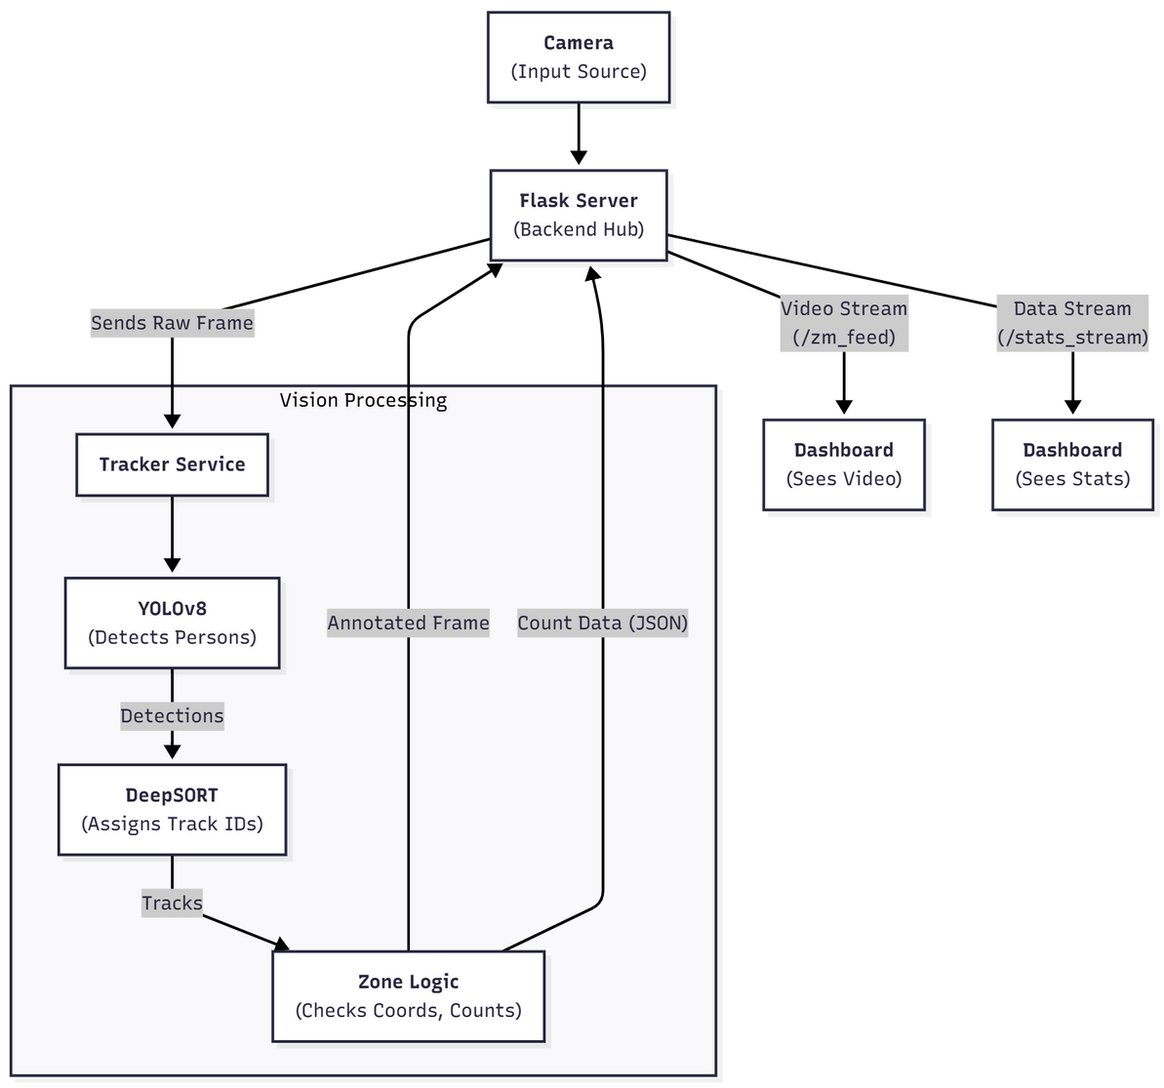
Proposed
Solution
Automated detection and counting using YOLOv8.
Real-time tracking with Deep SORT.
Smart dashboard for live stats and alerts.

Slide 4
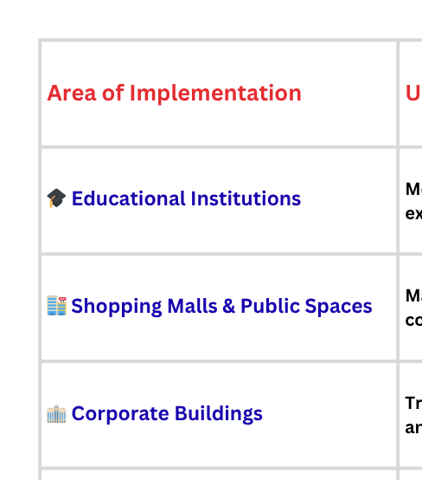

Real-World Implementation Areas

Slide 5
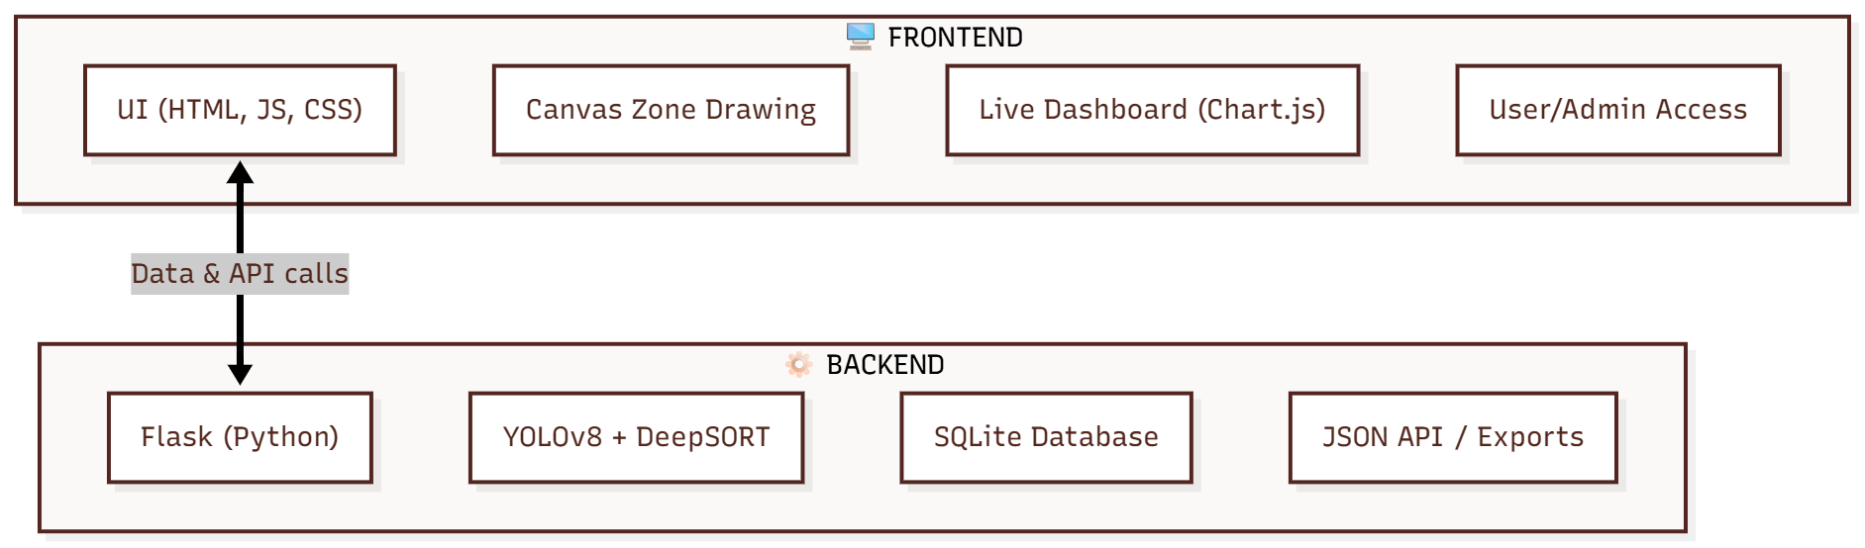
Project Architecture
Frontend
Built using HTML, CSS, and JavaScript for an interactive user interface.
Canvas API used for drawing and managing detection zones.
Chart.js visualizes real-time crowd data and alerts.
Provides user dashboards and admin panels for control and monitoring.
Backend
Developed using Flask (Python) as the main web server.
Handles video stream processing and model inference (YOLOv8 + Deep SORT).
Communicates with SQLite3 database to save zones, logs, and user data.
Provides REST APIs for uploading videos, tracking, exporting reports, etc.

Slide 6
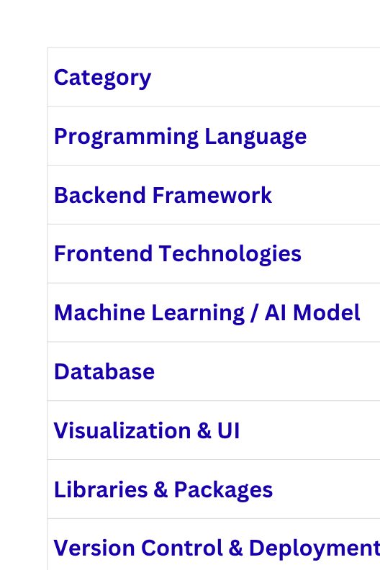
Tech Stack

Slide 7






System Workflow
⚙️ Processing Layer – Flask routes frames to YOLOv8 for detection; Deep SORT tracks individuals with unique IDs.
🧠 Analytics Layer – Counts people per zone, updates in real time, and triggers alerts on threshold breach.
🎥 Input Layer – Captures live or uploaded video feeds as the main data source.
📊 Presentation Layer – Live dashboard displays analytics, charts, and admin controls.
💾 Storage Layer – Saves users, zones, logs, and reports in an SQLite database.

Slide 8
Role-Based Access Control – Secure login with admin and user privileges
Live People Counting – Real-time detection and tracking using YOLOv8.
Threshold Alerts – Notifies users when a zone exceeds its defined capacity.
Key Features
of
CrowdCount
Custom Zone Creation – Draw and manage multiple regions of interest on video feeds.
Interactive Dashboard – Visualizes data using Chart.js (line & bubble charts).
Real-Time Updates – Automatic refresh of zone counts on the dashboard within seconds.
Data Export – Download analytics and logs in CSV or PDF format.
Multi-Camera Integration – Add or manage multiple IP or webcam feeds.

Slide 9
Execution Steps
1️⃣ Setup Environment
Install dependencies using pip install -r requirements.txt and ensure Python 3.9+ with webcam or video input.
2️⃣ Initialize Database
Run python app.py to auto-create video_zone.db and configure admin credentials.
3️⃣ Load / Stream Video
Use webcam or upload video from dashboard to start live feed.
4️⃣ Detection & Tracking
YOLOv8 detects people; Deep SORT tracks unique IDs in real time.
5️⃣ Live Counting & Alerts
Zones update counts automatically and trigger alerts on threshold breaches.
6️⃣ View Dashboard & Export
Monitor analytics, logs, and export data (CSV/PDF) from the dashboard.

Slide 10
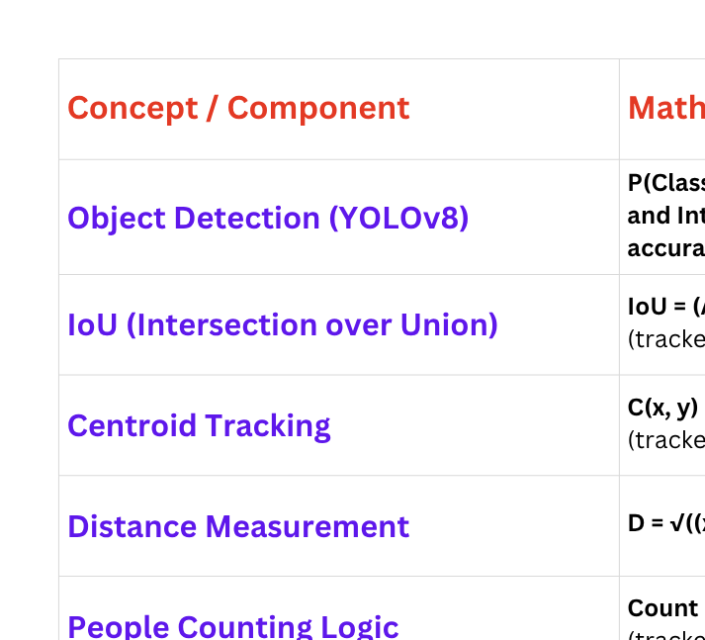
Mathematics & Formulas Behind the Project

Slide 11




Future Enhancements
Add multilingual options, voice assistance, and accessibility features to make the system inclusive and usable by diverse users.
Develop a mobile friendly dashboard accessible via smartphones for
real-time monitoring and alerts on the go.
Implement deep learning models to automatically identify unusual crowd movements, panic situations, or suspicious activities in real time.
Add automated voice or sound alerts when crowd thresholds are exceeded, improving real-time responsiveness.

Slide 12





